Slide 1
3D Image Segmentation and Quantification of Lysosomes
3/11/2025

Slide 2
What is “sigma” in this context?
When the program searches for blobs (round bright spots), it doesn’t just look at one size.
Instead, it uses many blurred copies of your image — each blurred by a different amount.
Each blur level is controlled by a number called σ (sigma).
What sigma means
Small σ (sigma) = detects tiny dots
Large σ (sigma) = detects bigger blobs
You can think of sigma as the radius of the magnifying glass used to look for bright round things.

Slide 3
Scales σ
Image blurred σ = 1 (fine details)
σ = 3 (medium spots)
σ = 8 (large spots)
At each scale, the computer asks:
“Is there a round bright area here that looks like a lysosome?”
Wherever it says “Yes”, it marks that location — and remembers which σ gave the strongest response.
That best σ value becomes that lysosome’s sigma.
So, each lysosome’s sigma tells you:
“At what blur size (or physical size) did this lysosome stand out most?”

Slide 4
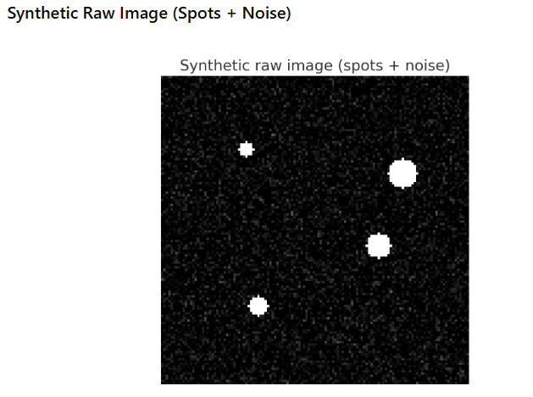
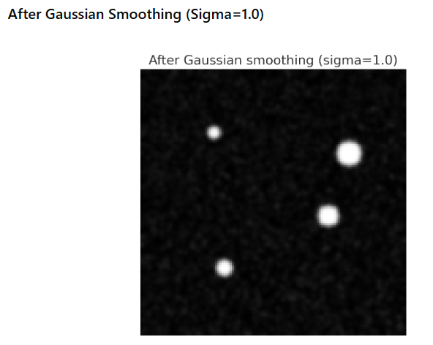
How does the program get that sigma?

Slide 5
How does the program get that sigma?
The program makes N versions of your image, blurred with different sigmas .
It computes something called the Laplacian of Gaussian (LoG) for each
version — basically a way to highlight circular bright regions.
It stacks all these results together.
For each pixel, it finds the sigma level where the signal (the “blob-ness”) is strongest.
That σ (sigma) becomes the blob’s scale — its size.
“For each bright spot, check at which scale it looks most circular — that scale is its sigma.”
Threshold: It is the sensitivity.
Lower = find more blobs (but noisier)
Upper = find less blobs(but less noise)

Slide 6
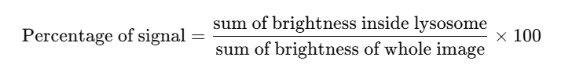
What about “percentage of the signal it takes”?
That refers to how strong the lysosome signal is compared to the whole image.
When a lysosome is detected, its intensity (brightness) can be compared to the total signal in the image:
This tells you how much of the total fluorescence comes from lysosomes.

Slide 7
Summary
The computer tests many blur levels (many σ values).
For each bright round region, it picks the σ that fits its size best.
That σ gives the lysosome’s scale (size).
Then, using the voxel size, it turns that into micrometers.
It can compare how much brightness (signal) those lysosomes
contribute to the total cell image — that’s the percentage of signal.

Slide 8
FILES
Airy scan_40A_UAS-TMEM-HA_CB_0h_1_051222
Airy scan_40A_UAS-TMEM-HA_CB_0h_2_051222
Airy scan_40A_UAS-TMEM-HA_CB_4h_1_051222
Airy scan_40A_UAS-TMEM-HA_CB_4h_2_051222
40A_UAS-TMEM192-3xHA x 40A 71G10 MARCM_around 12h - for quantification_4 Airy-CBs_300425
40A_UAS-TMEM192-3xHA x 40A 71G10 MARCM_around 12h - for quantification_3 Airy-CBs_300425
40A_UAS-TMEM1923x-HA x 71G10 40A MARCM_L3_2_Airy_010724
40A_UAS-TMEM1923x-HA x 71G10 40A MARCM_L3_1_Airy_010724

Slide 9
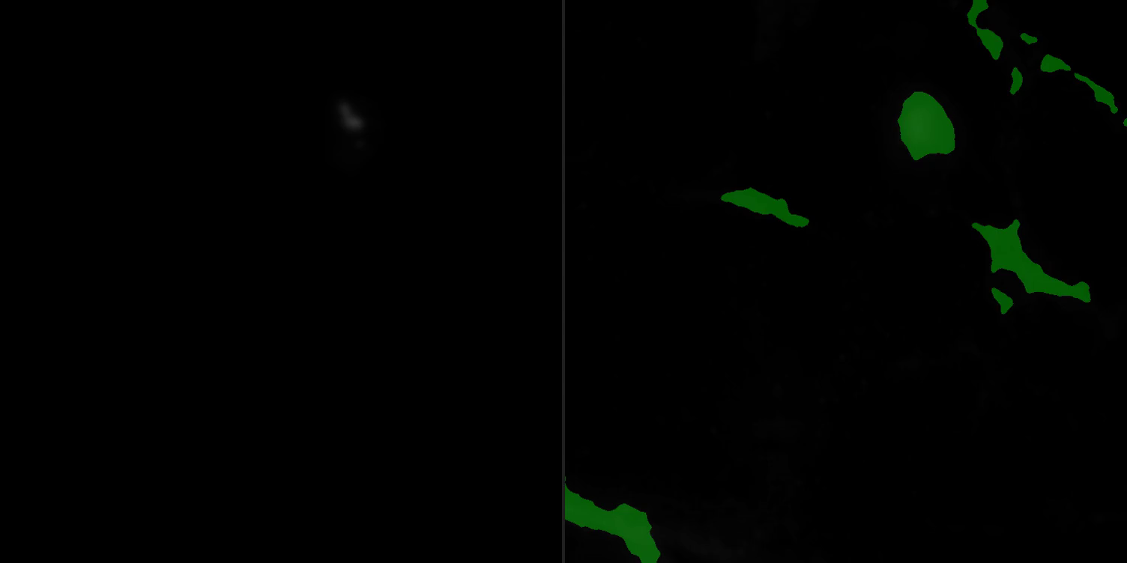
Airy scan_40A_UAS-TMEM-HA_CB_0h_1_051222

Slide 10
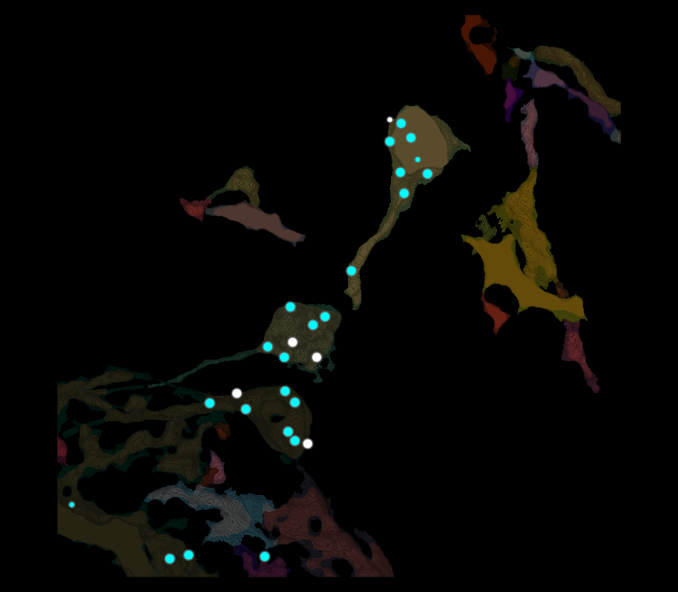
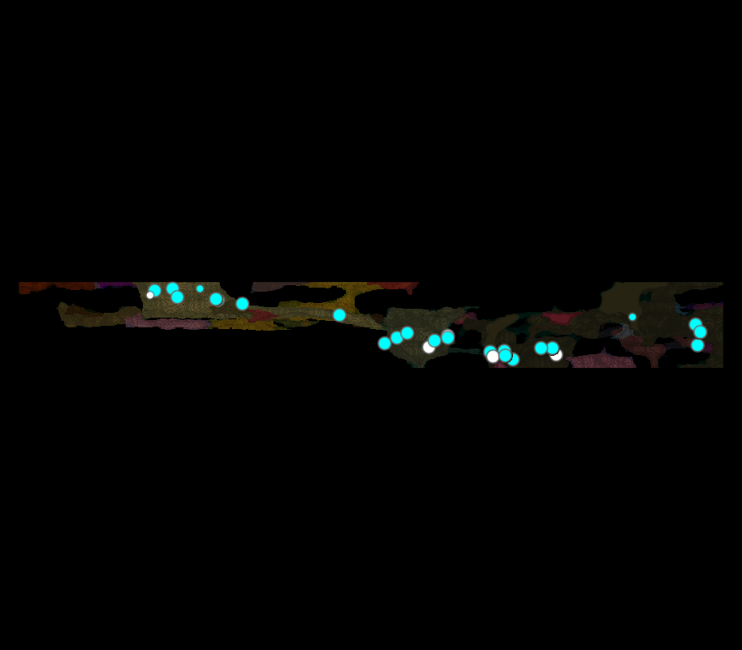
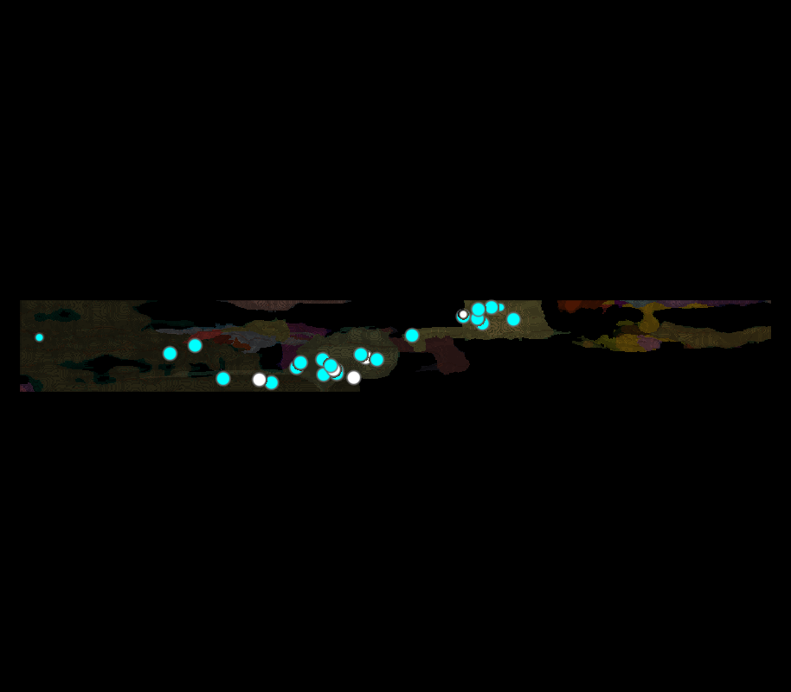
Airy scan_40A_UAS-TMEM-HA_CB_0h_1_051222

Slide 11
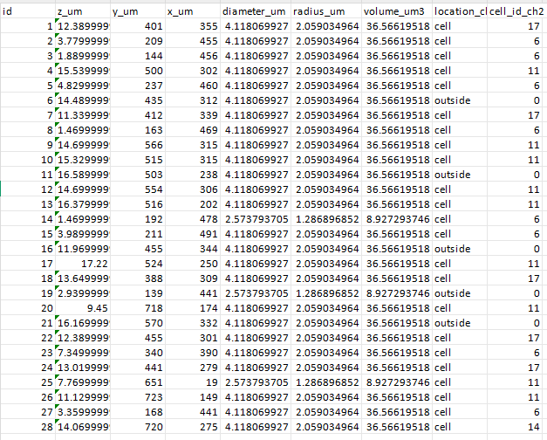
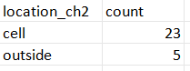
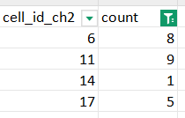
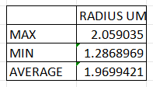
Airy scan_40A_UAS-TMEM-HA_CB_0h_1_051222
TOTAL LYSOSOMES
28

Slide 12
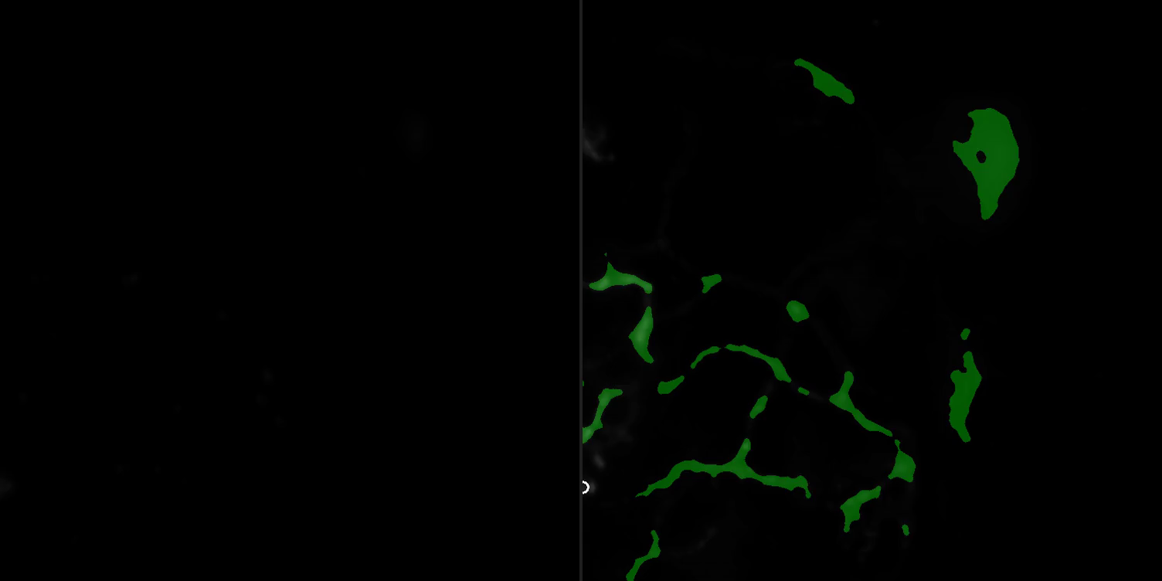
Airy scan_40A_UAS-TMEM-HA_CB_0h_2_051222

Slide 13
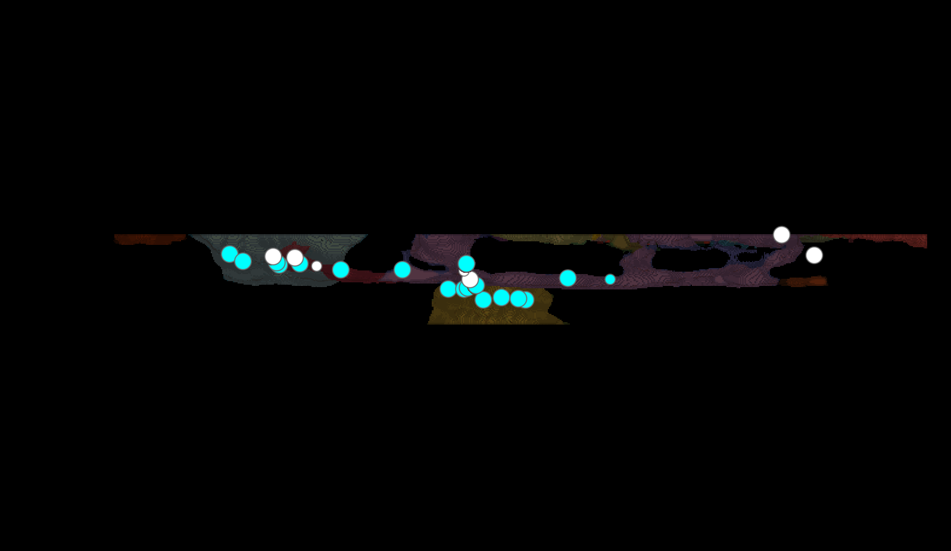
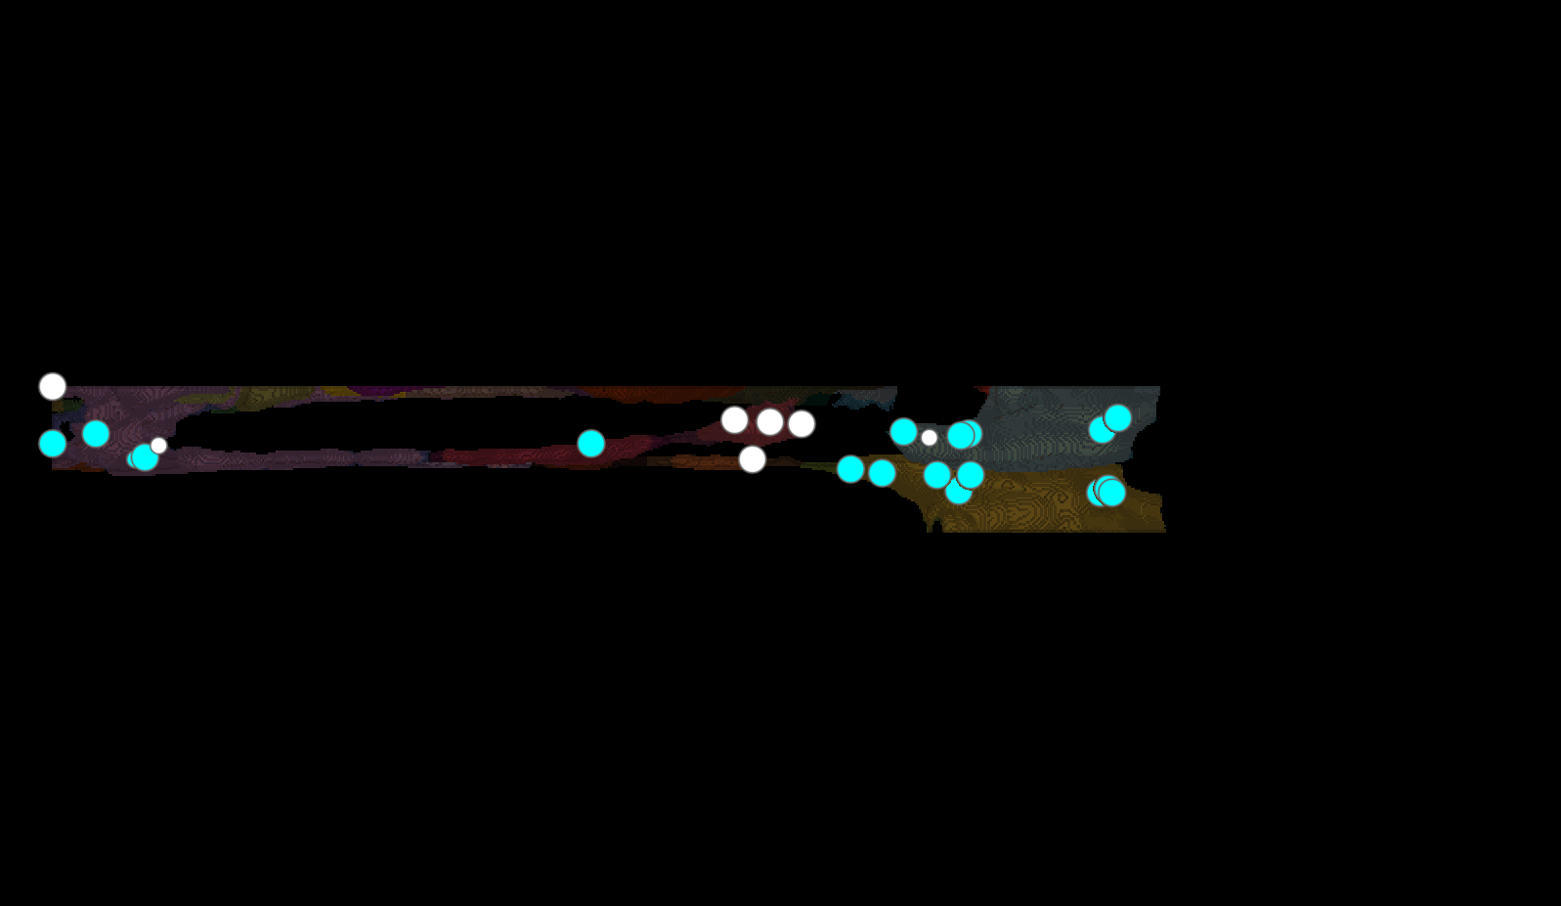
Airy scan_40A_UAS-TMEM-HA_CB_0h_2_051222

Slide 14
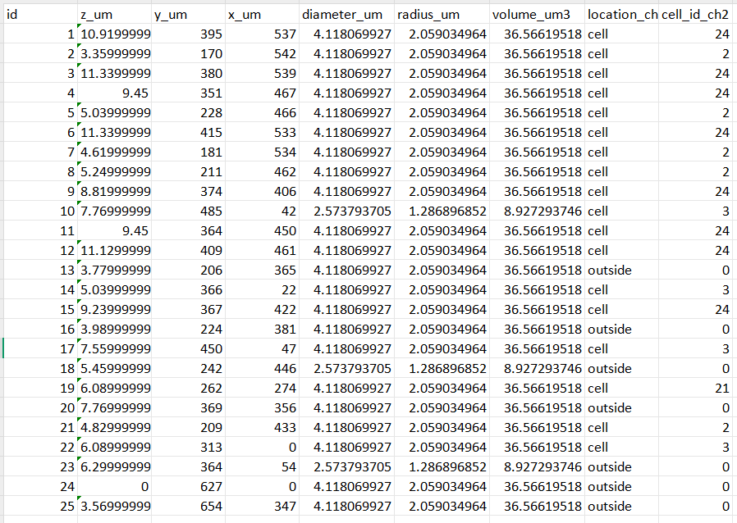
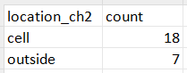
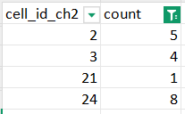
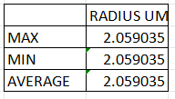
Airy scan_40A_UAS-TMEM-HA_CB_0h_2_051222
TOTAL LYSOSOMES
25

Slide 15
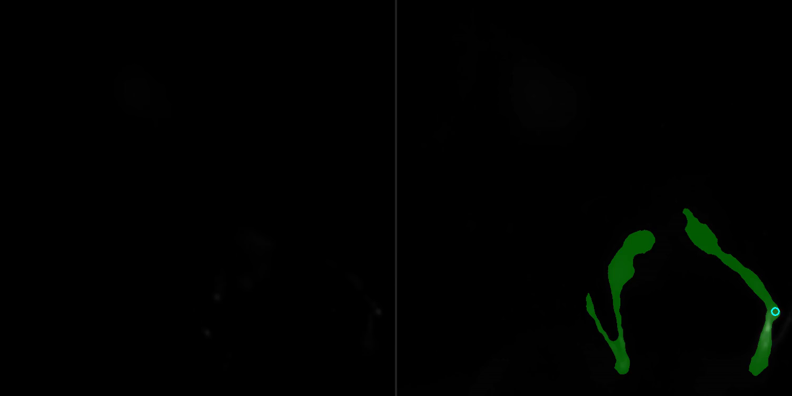
Airy scan_40A_UAS-TMEM-HA_CB_4h_1_051222

Slide 16
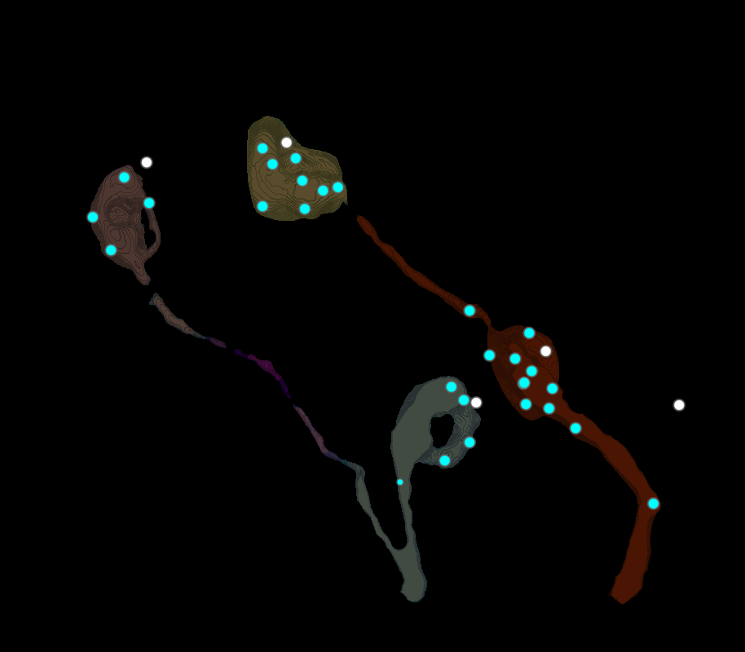
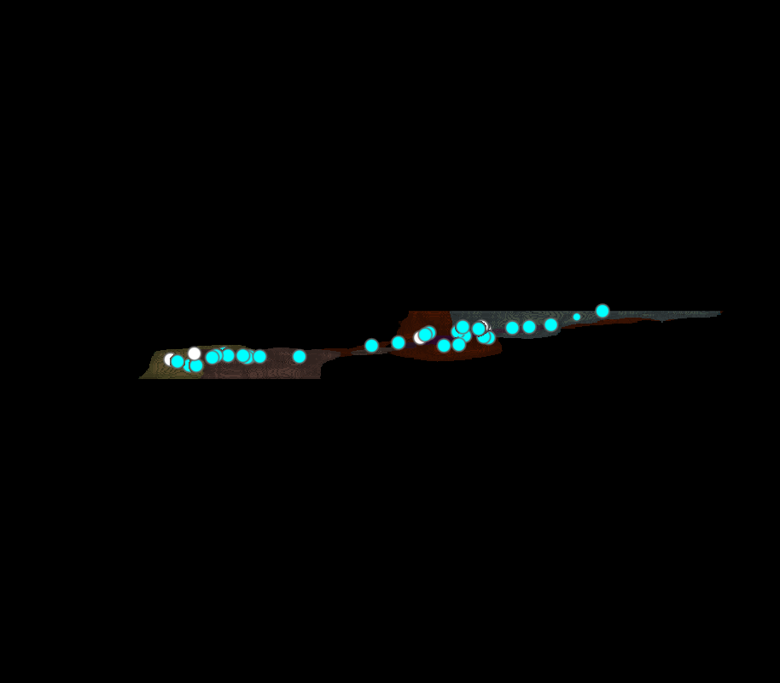
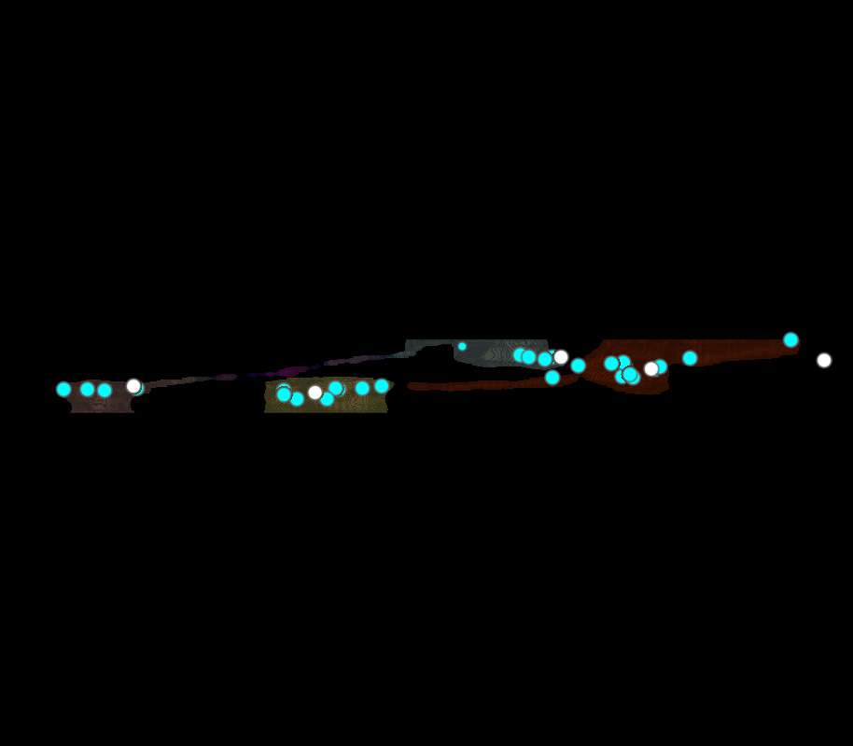
Airy scan_40A_UAS-TMEM-HA_CB_4h_1_051222

Slide 17
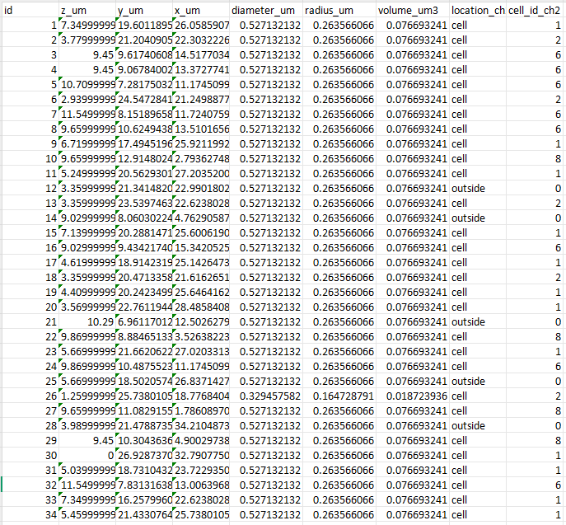
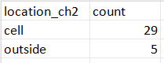
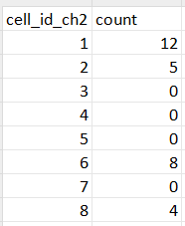
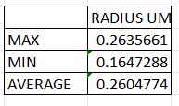
Airy scan_40A_UAS-TMEM-HA_CB_4h_1_051222
TOTAL LYSOSOMES
34

Slide 18
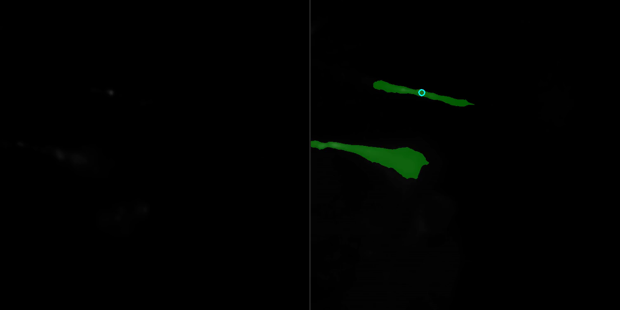
Airy scan_40A_UAS-TMEM-HA_CB_4h_2_051222

Slide 19
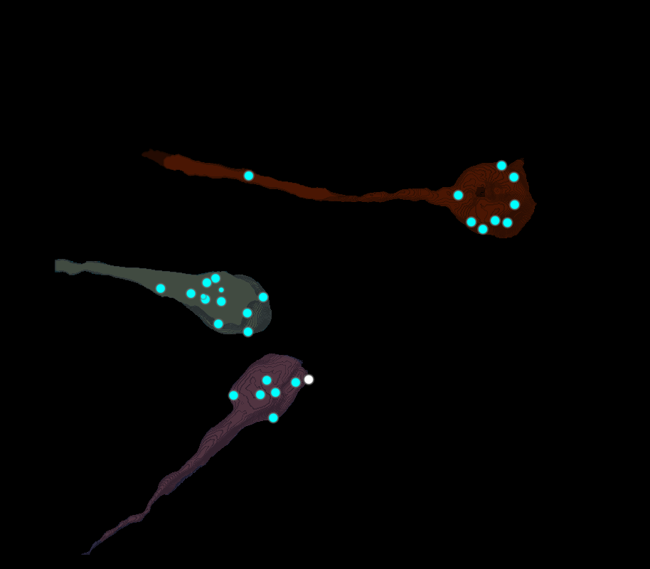
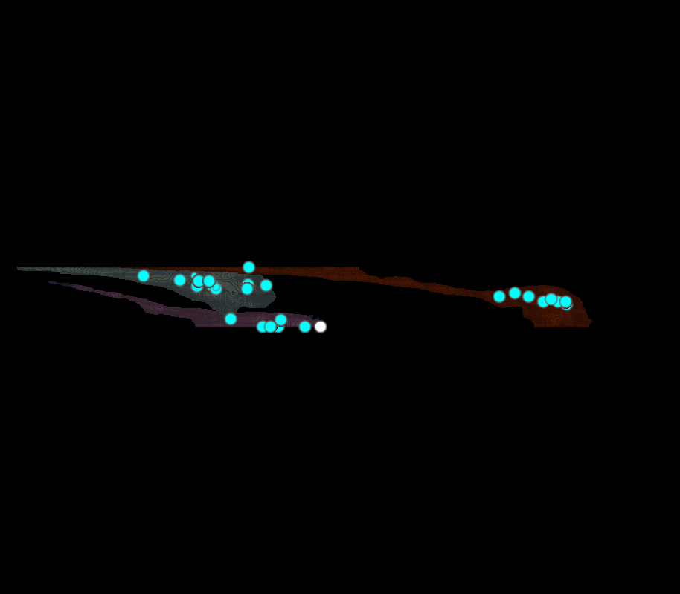
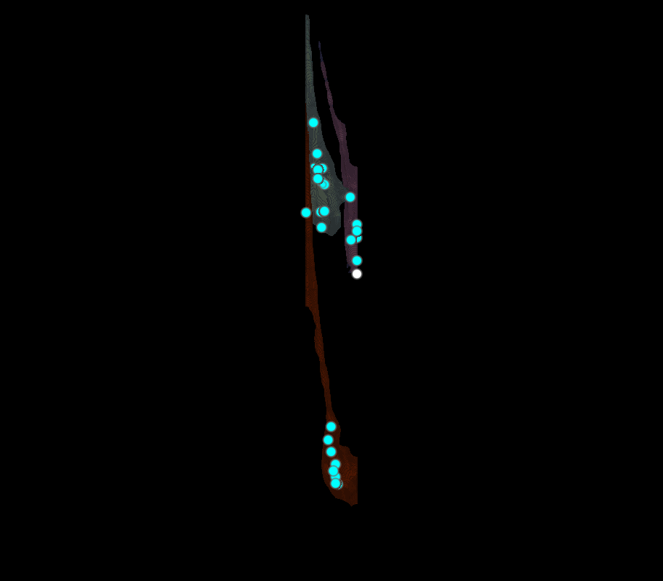
Airy scan_40A_UAS-TMEM-HA_CB_4h_2_051222

Slide 20
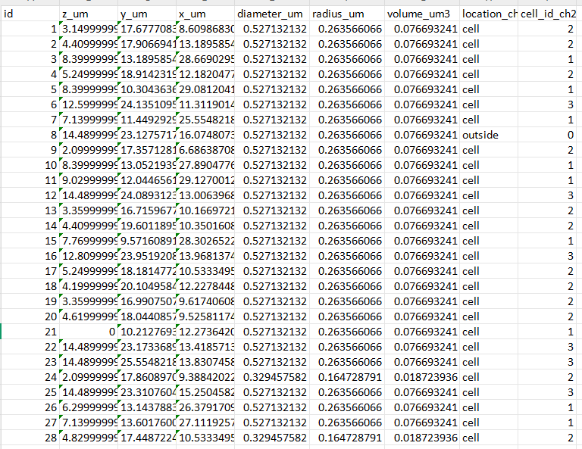
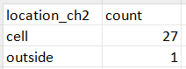
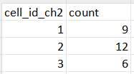
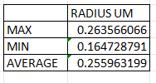
Airy scan_40A_UAS-TMEM-HA_CB_4h_2_051222
TOTAL LYSOSOMES
28

Slide 21
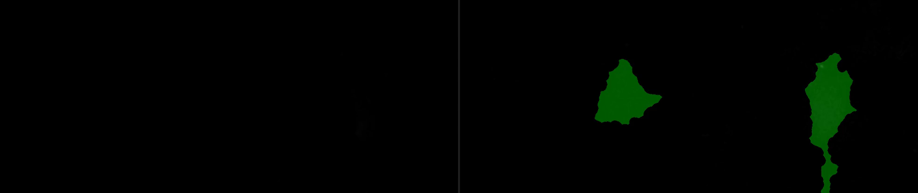
40A_UAS-TMEM192-3xHA x 40A 71G10 MARCM_around 12h - for quantification_4 Airy-CBs_300425

Slide 22
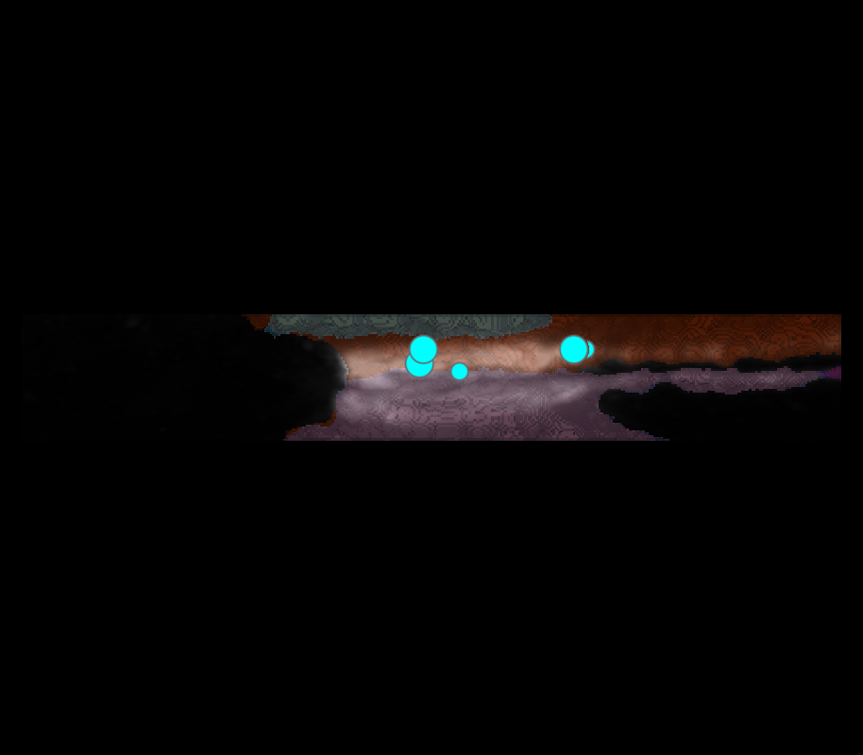
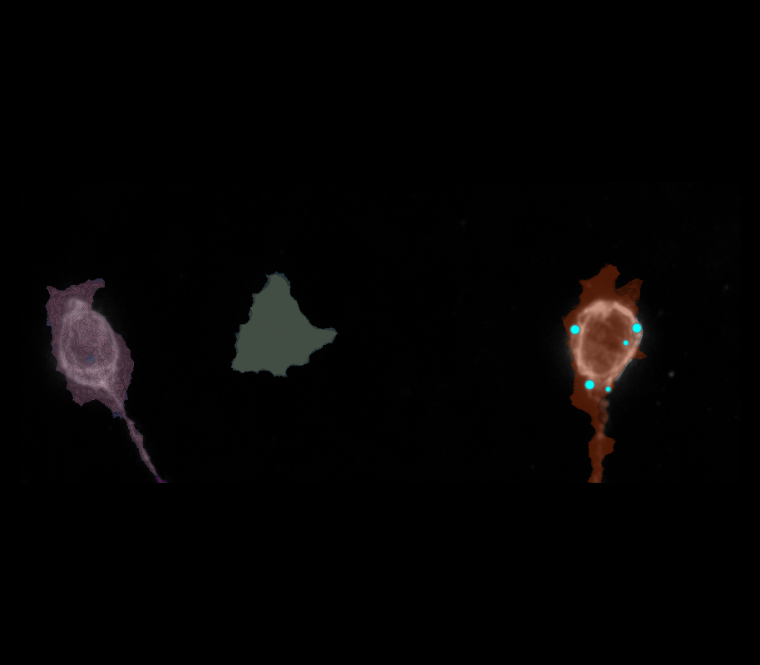
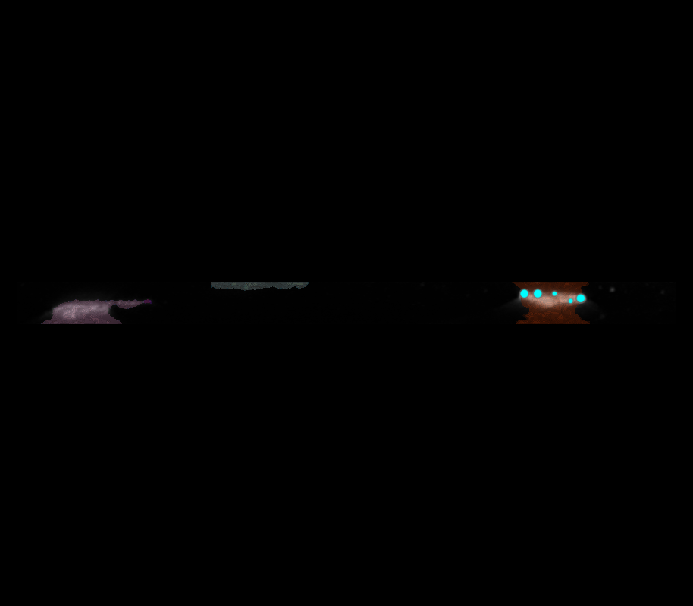
40A_UAS-TMEM192-3xHA x 40A 71G10 MARCM_around 12h - for quantification_4 Airy-CBs_300425

Slide 23
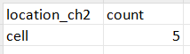
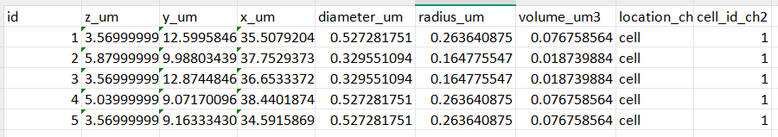
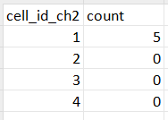
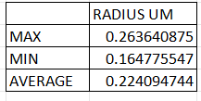
40A_UAS-TMEM192-3xHA x 40A 71G10 MARCM_around 12h - for quantification_4 Airy-CBs_300425
TOTAL LYSOSOMES
28

Slide 24
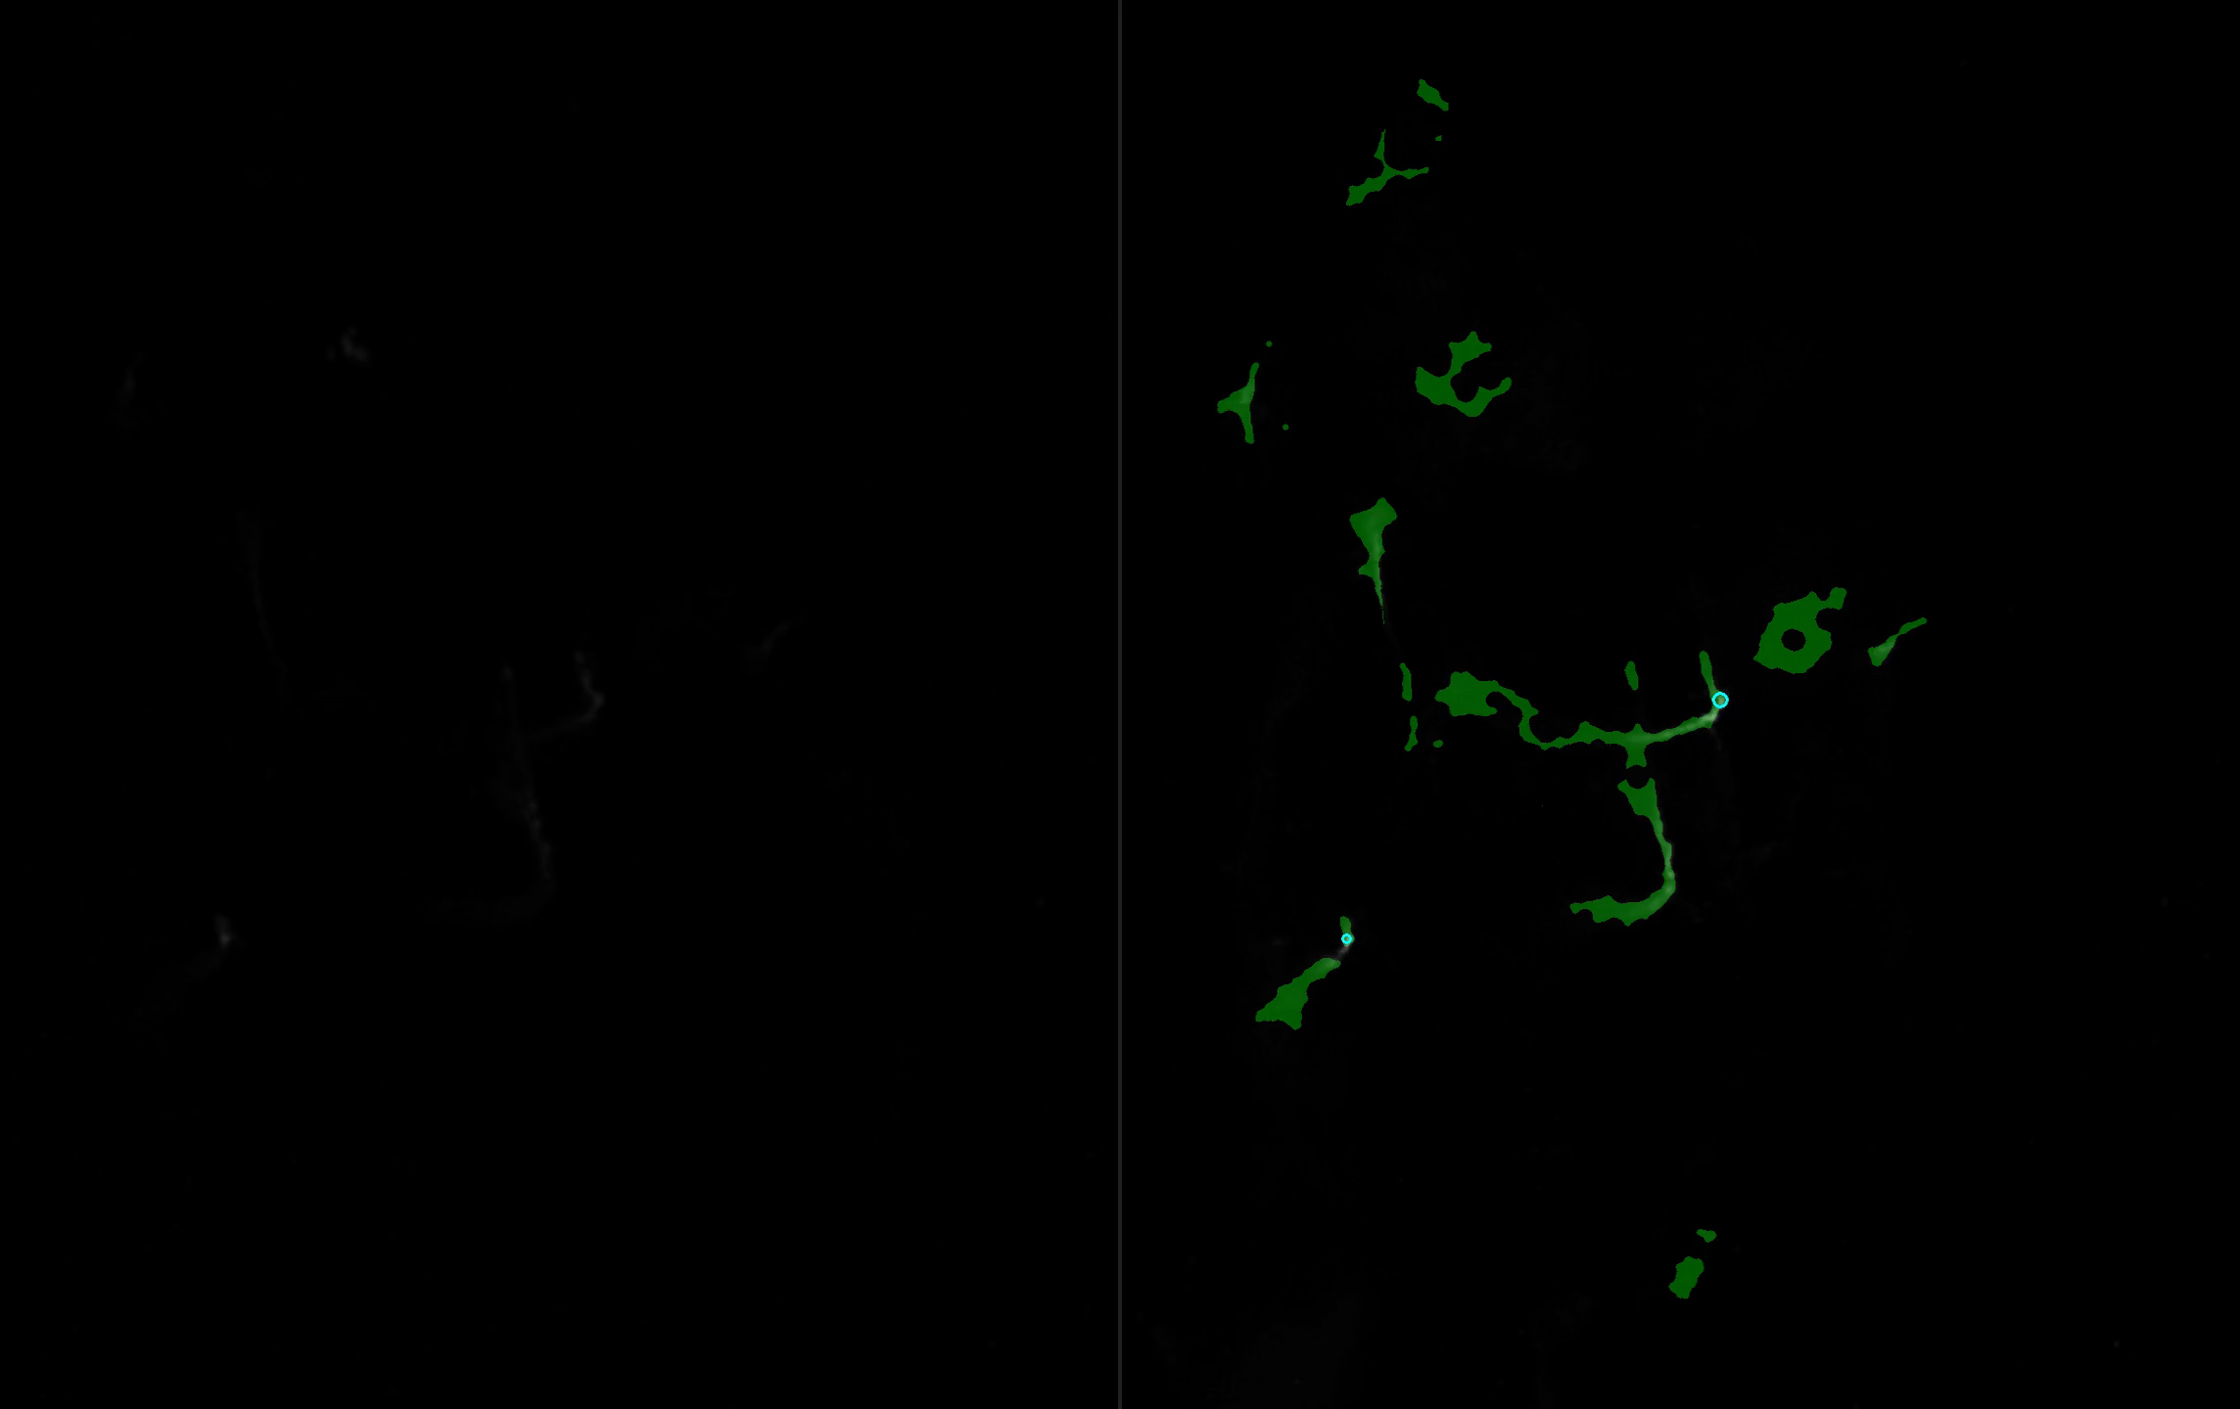
40A_UAS-TMEM192-3xHA x 40A 71G10 MARCM_around 12h - for quantification_3 Airy-CBs_300425

Slide 25
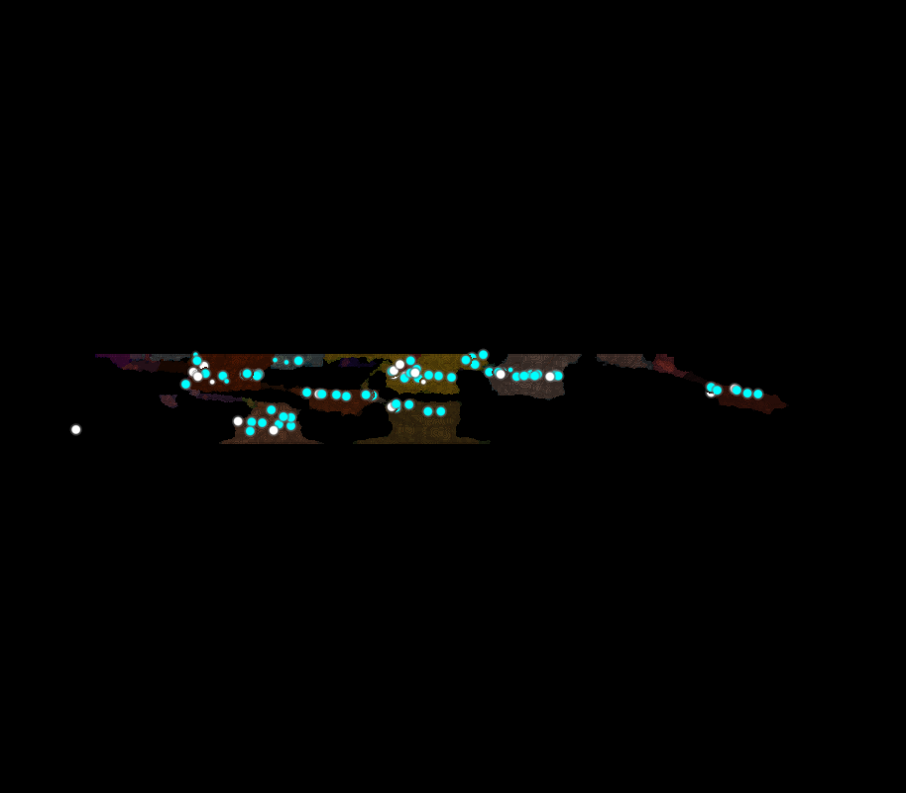
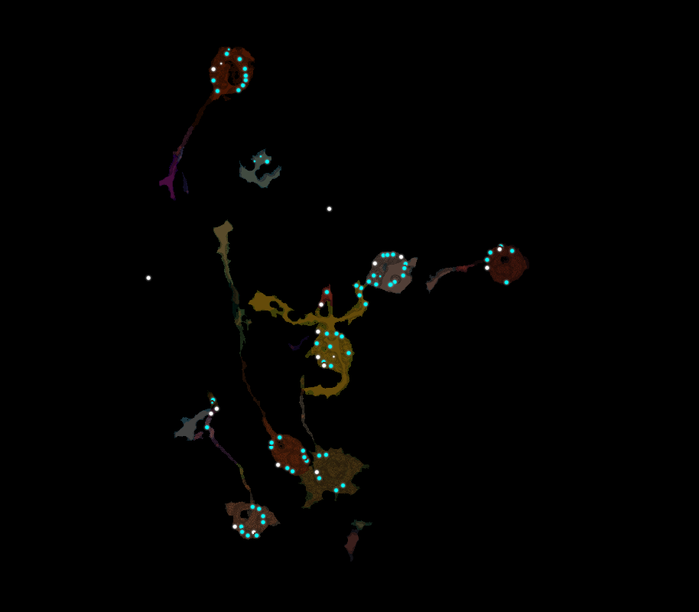
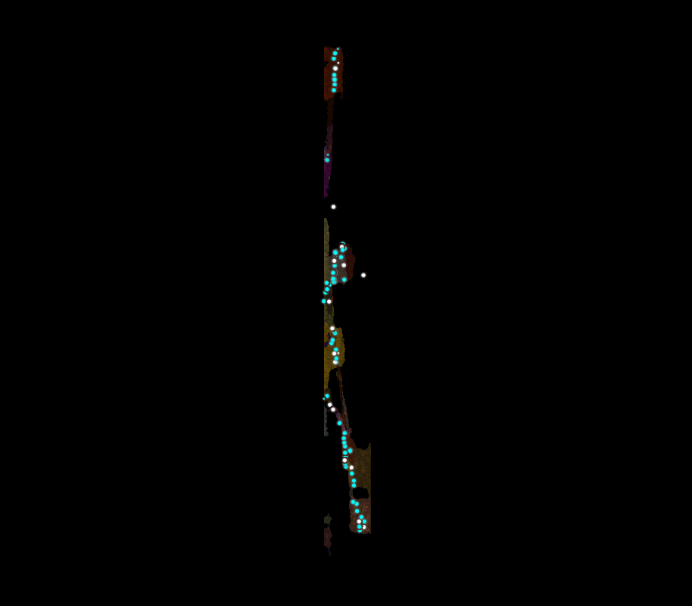
40A_UAS-TMEM192-3xHA x 40A 71G10 MARCM_around 12h - for quantification_3 Airy-CBs_300425

Slide 26
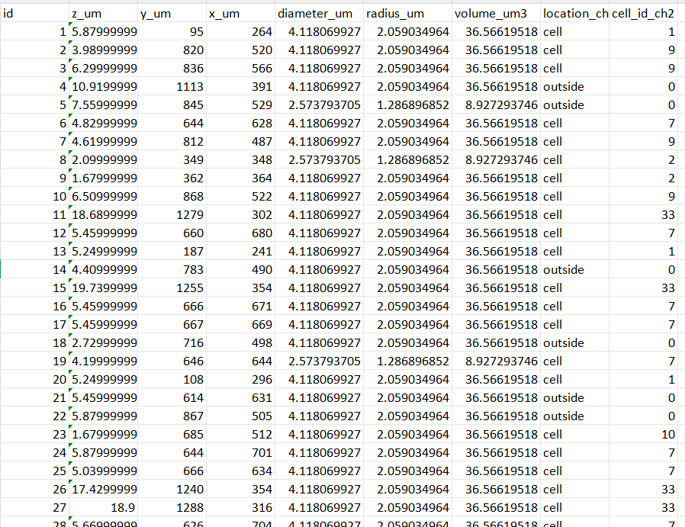
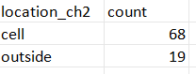
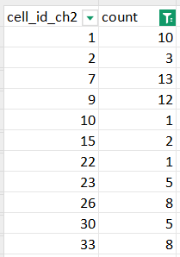
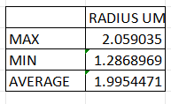

40A_UAS-TMEM192-3xHA x 40A 71G10 MARCM_around 12h - for quantification_3 Airy-CBs_300425
TOTAL LYSOSOMES
87

Slide 27

40A_UAS-TMEM1923x-HA x 71G10 40A MARCM_L3_2_Airy_010724

Slide 28



40A_UAS-TMEM1923x-HA x 71G10 40A MARCM_L3_2_Airy_010724

Slide 29





40A_UAS-TMEM1923x-HA x 71G10 40A MARCM_L3_2_Airy_010724
TOTAL LYSOSOMES
345

Slide 30

40A_UAS-TMEM1923x-HA x 71G10 40A MARCM_L3_1_Airy_010724

Slide 31



40A_UAS-TMEM1923x-HA x 71G10 40A MARCM_L3_1_Airy_010724

Slide 32





40A_UAS-TMEM1923x-HA x 71G10 40A MARCM_L3_1_Airy_010724
TOTAL LYSOSOMES
215

